Slide 1
Crowdfunding with smart contracts
Suklesh Rao (16z355),
Shivani B(17Z348),
Hareeshwar K (17Z317),
Tejas Badani (17Z354),
Pravin prabhu S(18Z471)
GUIDE : Dr. Sathiyapriya.K

Slide 2
AGENDA
Introduction
Motivation
Literature Survey
Problem Statement
Objective
Scope and applications
Design
Methodology
Implementation
Result Analysis
Conclusion and Future work
References

Slide 3
iNTRODUCTION
Crowdfunding is a process of raising funds for a project or venture from the masses that is the burden of investment is distributed across the masses.
Blockchain technology and digital currencies have proven to be capable of being retrofitted to meet the needs of any industry, including the time-tested ones.
The crowdfunding platform is a peer-to-peer fundraising model that provide different possibilities for the start-ups by raising funds.
By programming a set of pre-defined crowdfunding conditions on smart contracts, the system can be automated to execute the smart contract to issue certain rewards based on the amount contributed towards the campaign.

Slide 4
mOTIVATION
Crowdfunding allows businesses with great products and service ideas to raise funds from regular people in small investment amounts.
Companies like Kickstarter, Indiegogo, and Crowdfunder were among the earliest to make it popular.
According to Kickstarter, 78% of campaigns that raise 20% of their goal ultimately become fully funded, while 11% of projects finish having never received any funding at all.
Blockchain can change the crowdfunding landscape by making the funding process safe.
It offers completely transparent access from anywhere in the world.

Slide 5
LITERATURE SURVEY
Paper Name | Author | Key Points
Application of blockchain technology of crowdfunding using smart contract | Kangana W. M, Sowmya M, Namita Chougule, Sejal Patil, Soumya Kadadi | Web-based application Ensures security for the contribution amount Uses a voting system to provide the money provided by the donors to the campaign creator.
BitFund: A Blockchain-based Crowd Funding Platform for Future Smart and Connected Nation | Vikas Hassija, Vinay Chamola, Sherali Zeadally | Proposed a unique and secure crowdfunding platform based on blockchain and Ethereum smart contracts. Implement iterative auction algorithms that allow developers to vary their bid amounts over iterations to increase their winning chances. Eliminated the need for any manual negotiation between investors and developers for the project's parameters.
Pledgecamp the next generation of crowdfunding | https://pledgecamp.com/ | Introduced the use of tokens Parties are incentivized towards shared goals Introduced accountability and transparency with smart contracts and aligning user interests through an inclusive and rewarding token economy.
Based Crowdfunding: A'Pay-it-Forward' Model of WHIRL | Hasnan Baber | Worked on the principle of "Pay-it-forward” Works based on Karma points

Slide 6
PROBLEM STATEMENT
In a centralized crowdfunding management system, the mutable records of the transactions could be exploited.
Most of the current platforms are run by a company and once the donor has parted with her cash, it is up to the company to secure this money and transfer it.
Crowdfunding has become a popular way to democratize fundraising for many new age start-ups.
But the current crowdfunding platforms are centralized which means the funds are controlled by the platform.
The activities done are not fully transparent and are not publicly tracked, potentially leading to scams and loss of funds.

Slide 7
OBJECTIVE
This crowdfunding project powered by Blockchain aims to:
Allow anybody on the network to start a project for funding
Enable the projects to receive donations from anyone with an Ethereum wallet
Verify proper usage of funds by Moderators who could be random people on the network
Provides incentives for the Moderators and the Project Creators to compensate their work
Provide transparency to the donors about the transactional activities with their donations

Slide 8
SCOPE AND APPLICATIONS
This project's scope extends to the funding and transactional activities being tracked publicly by anyone on the network and brings down the possibility of fraudulent activities.
Some of the applications to which this project can be extended are as follows:
Initial Coin Offerings (ICO) of organizations offering their cryptocurrency
Charity campaigns by governmental and non-governmental organizations
Relief fund donations during period of pandemics or natural disasters

Slide 9
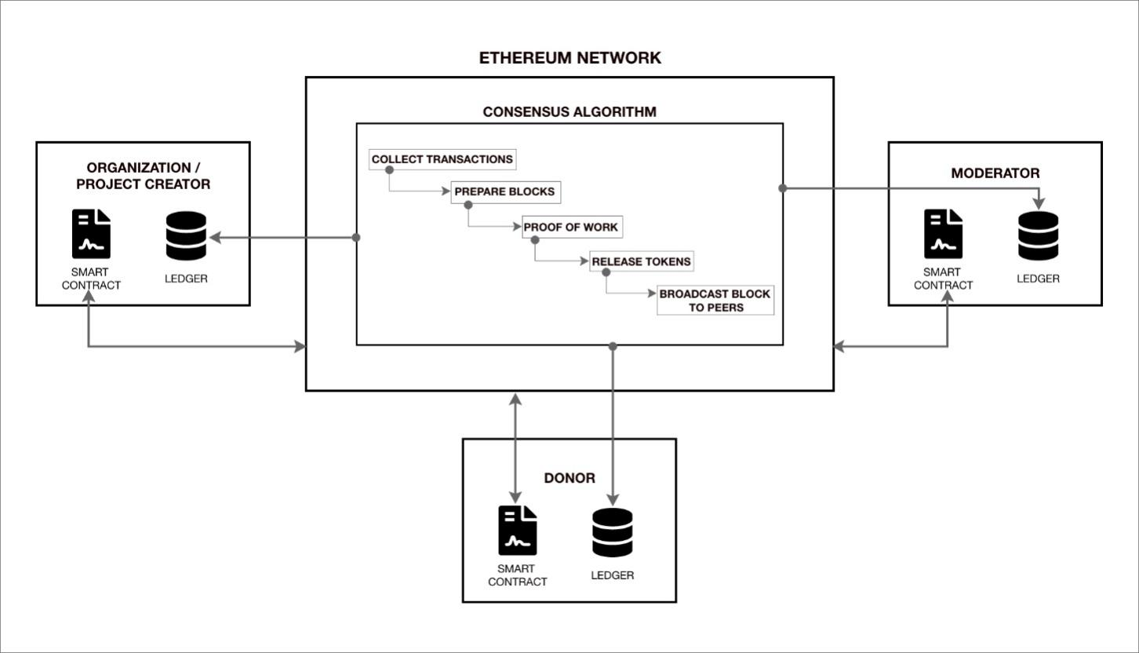
DESIGN-architecture diagram

Slide 10
METHODOLOGY
Writing Smart Contracts
Migrating to the Ganache Local Personal Development Blockchain
Testing the Smart Contracts
Compiling the Smart Contracts
Creating an user interface to interact with our smart Contracts from a web browser

Slide 11


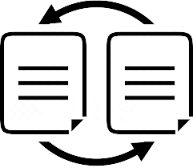
IMPLEMENTATION
Smart contract
A "smart contract" is simply a program that runs on the Ethereum blockchain.
Once they are deployed on the network you can't change them.
Migrations
Migrations are JavaScript files that help to deploy contracts to the Ethereum network.
Gas Fee
Fee required to conduct a transaction on the Ethereum network.
It's a collection of code (its functions) and data (its state) that resides at a specific address on the Ethereum blockchain.
These files are responsible for staging the deployment tasks, and they're written under the assumption that the deployment needs will change over time.
Paid in Ethereum’s native currency – ether.

Slide 12
IMPLEMENTATION - technology stack
HTML(for web design)
CSS(for styling)
NodeJS & JavaScript(for deployment of the contracts on the blockchain network and testing)
Ganache(for wallets)
Truffle(for migration)
Solidity(for smart contracts)

Slide 13
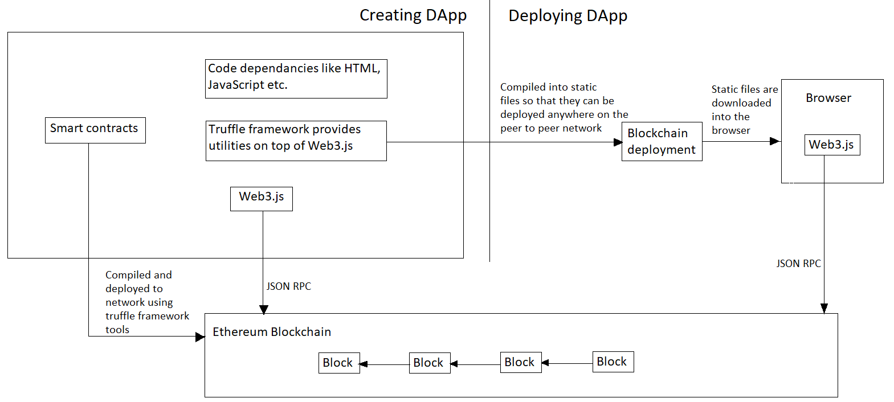
IMPLEMENTATION - AN OVERVIEW

Slide 14
Steps of Implementation
Installing MetaMask,Ganache,Truffle
Creating SmartContract using Solidity Language
Deploying our contract using Truffle in Ganache Network
Creating the JavaScript application
Integrating the SmartContract Logic into the JavaScript program
Running the JavaScript Application
Ensuring MetaMask & Ganache are in Sync
Triggering “Write” Transaction via JavaScript Application & paying Gas Fee to submit the transaction via MetaMask

Slide 15
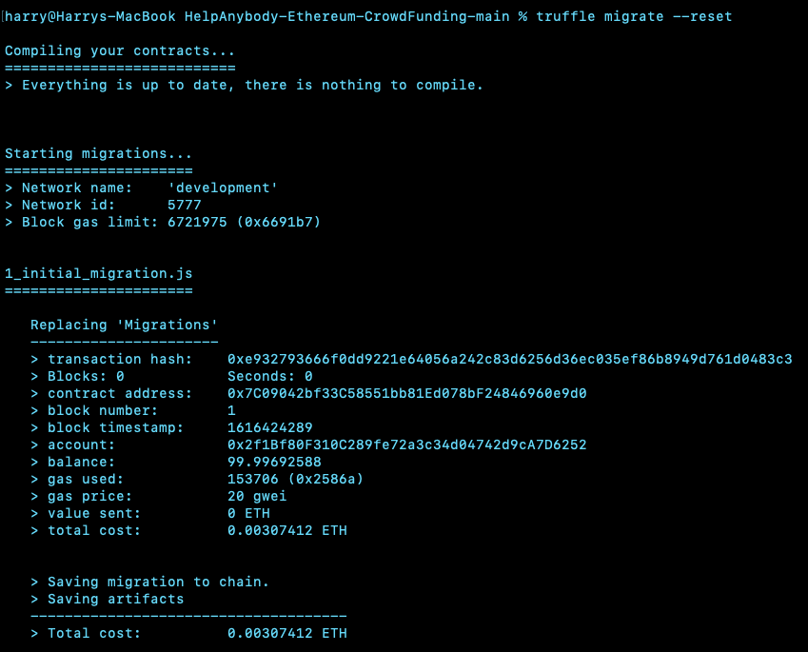
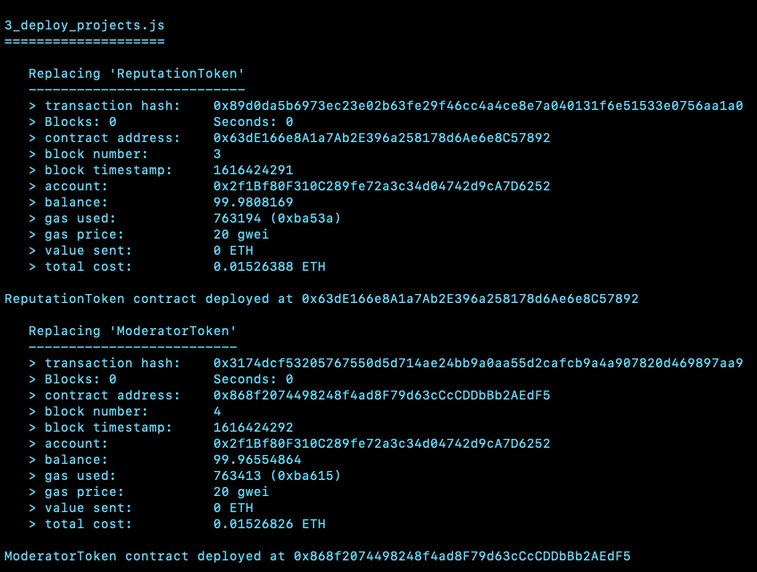
Results - backend
Initial migration and smart contract deployment

Slide 16
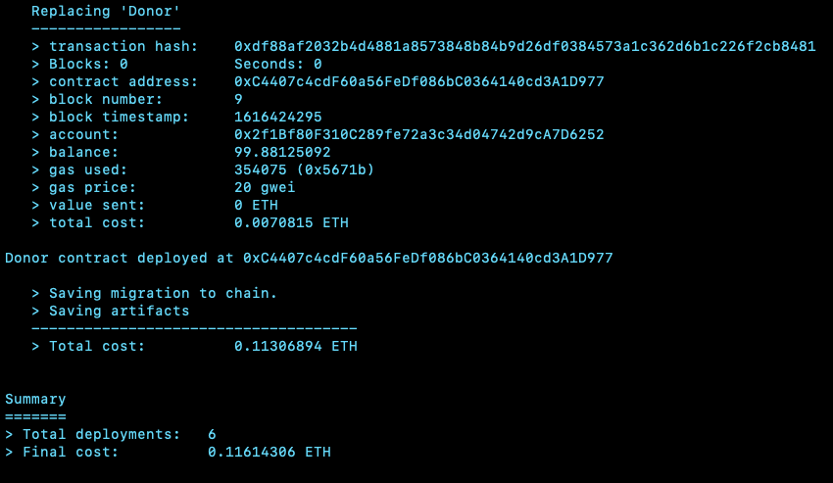
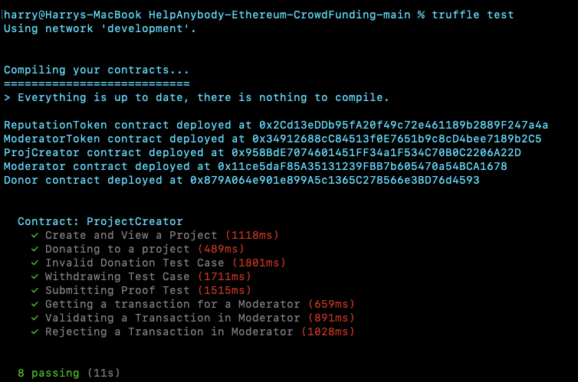
Results - backend
Compilation and Migration Summary

Slide 17
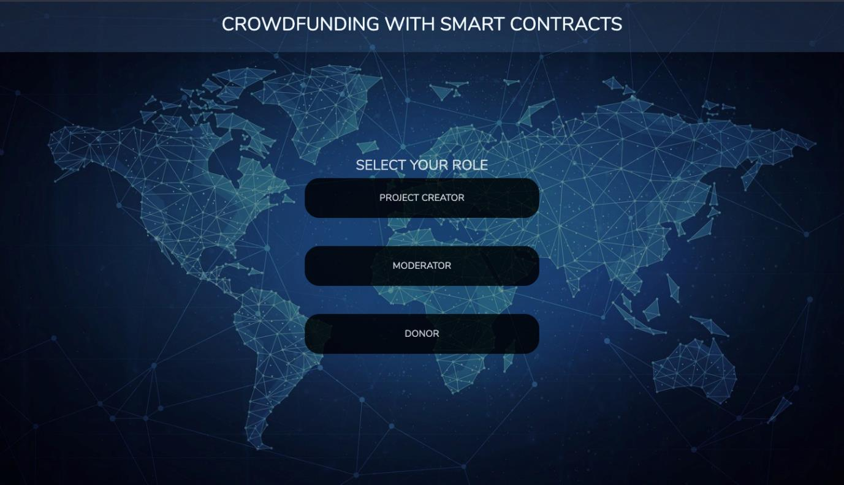
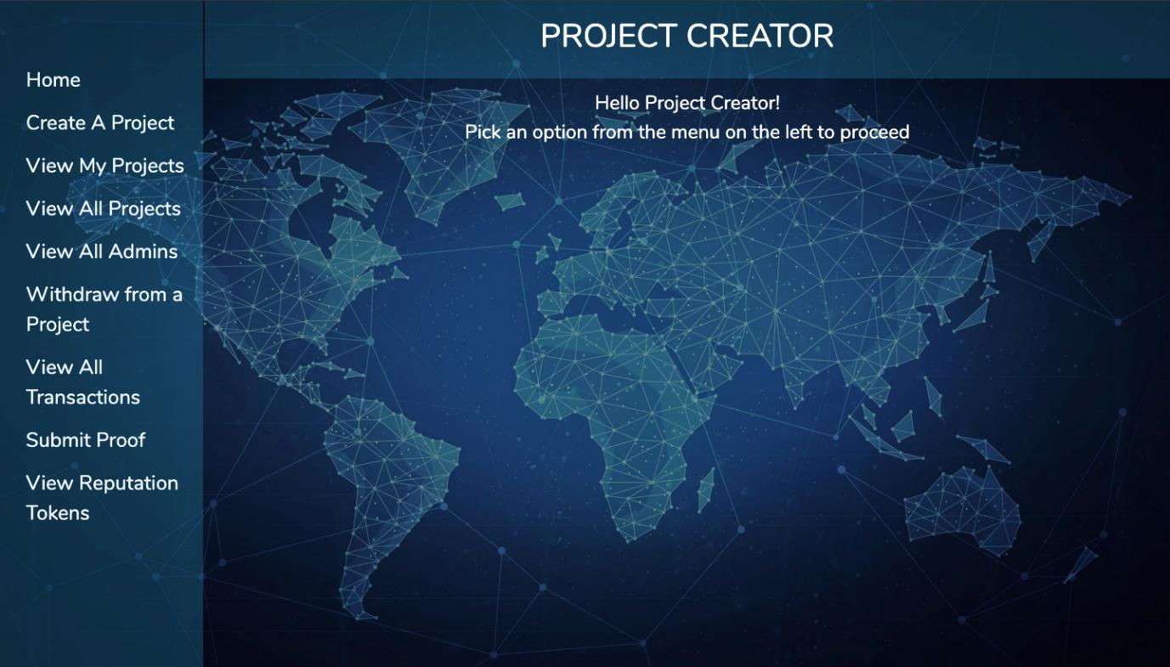
results - frontend
Home page and Project Creator’s home page

Slide 18
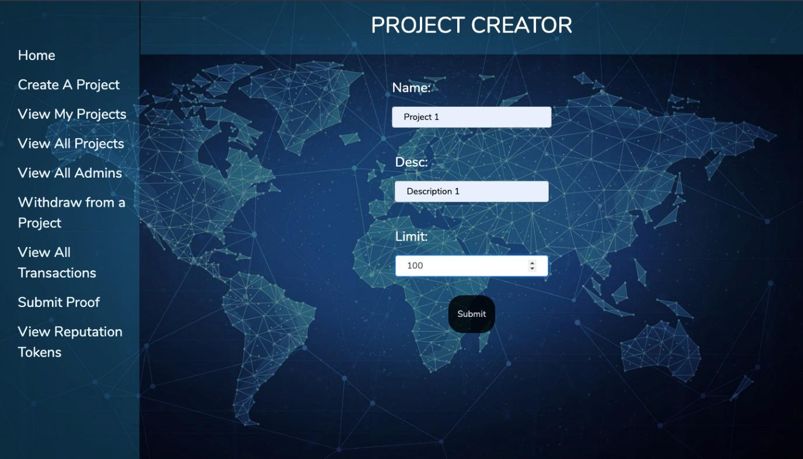
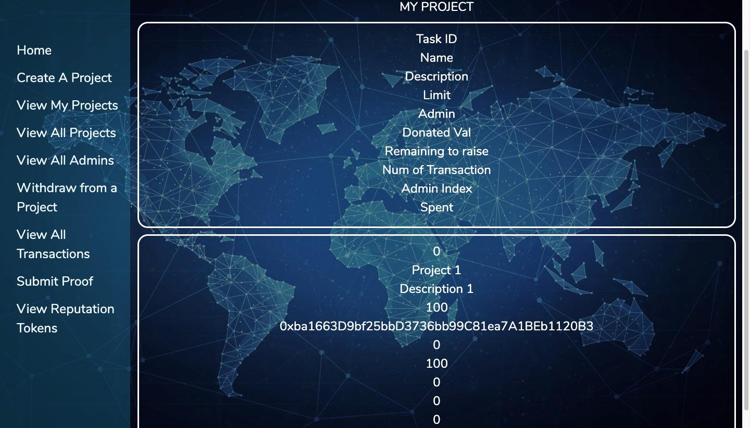
results - frontend
The following figures depicts the page to view the projects created by the project creator and the page to view all the admins of a particular project.
Create Project for Project creator
View Project for Project creator

Slide 19
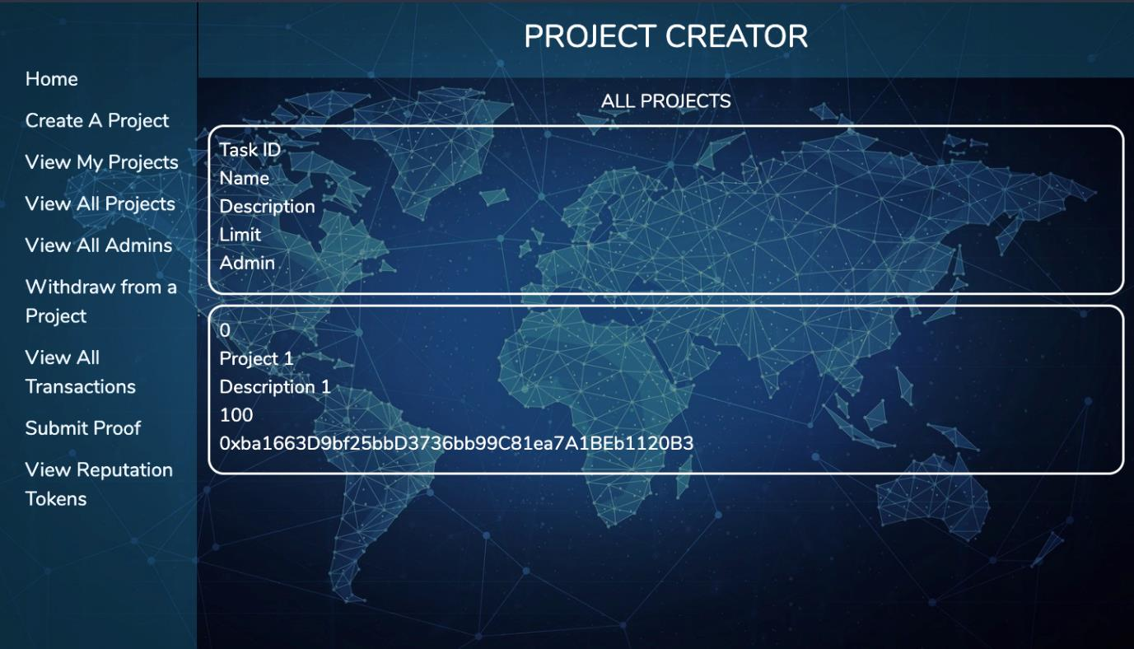
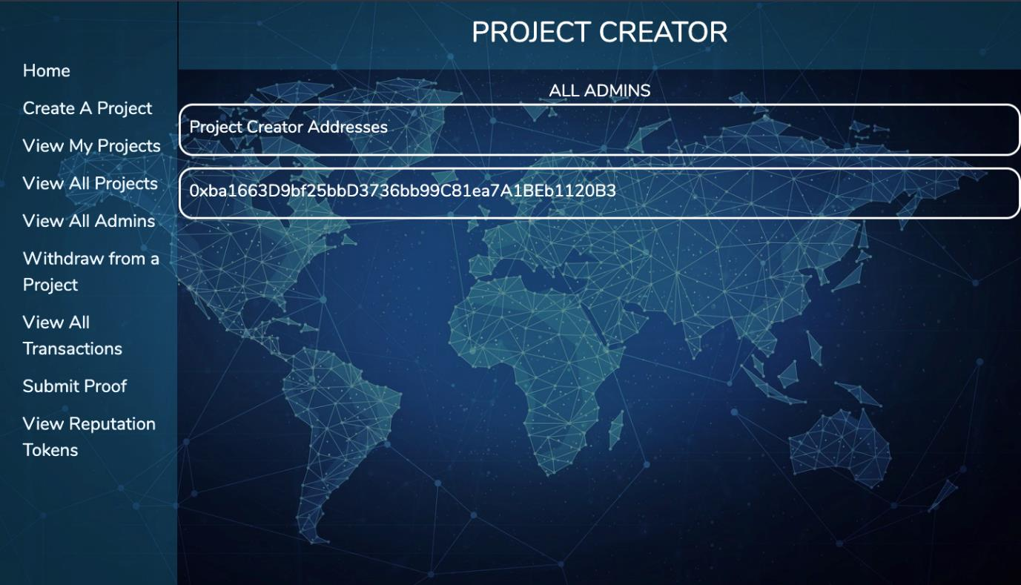
results - frontend
The following figures depicts the form for project creation by the project creator and the page to view the all the projects created in the network
View Project for Project creator
View Admin for Project creator

Slide 20
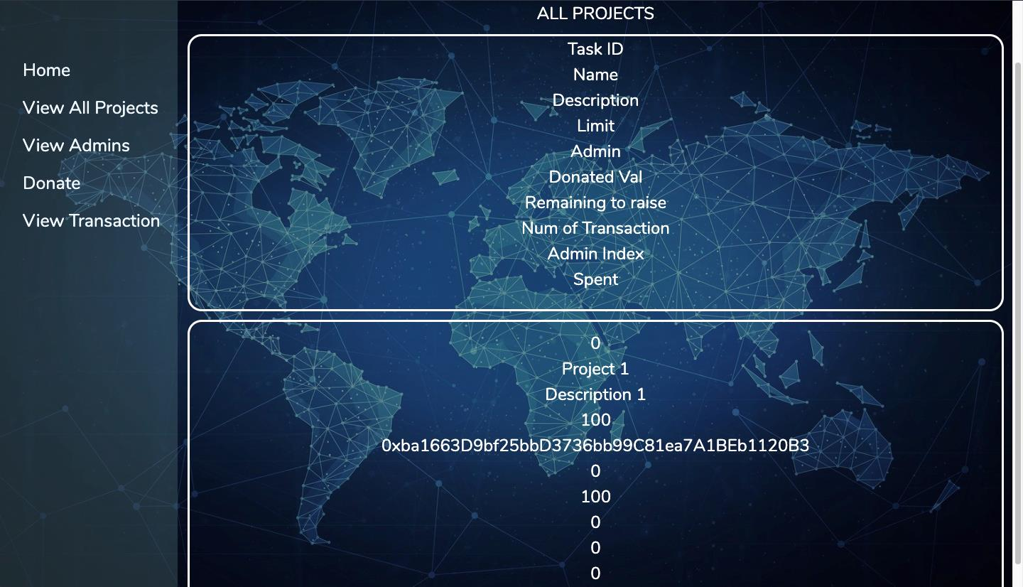
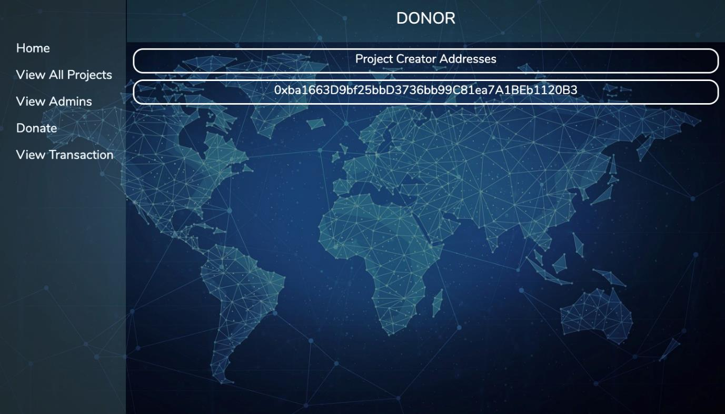
results - frontend
View Project for Donor
View Admin for Donor

Slide 21
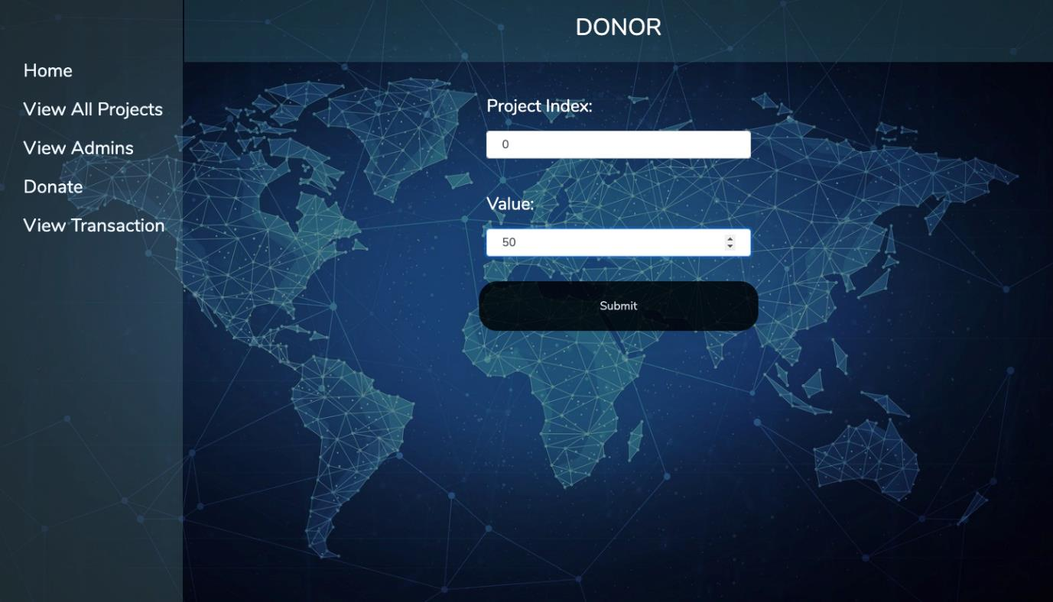
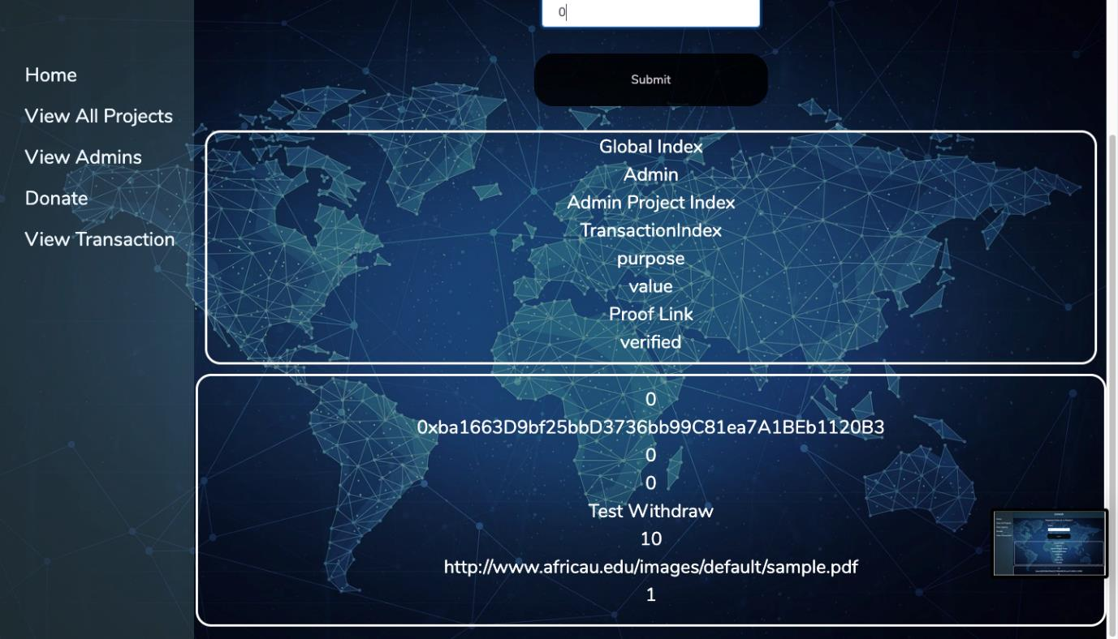
results - frontend
Donate to Project for Donor
View transactions for Donor

Slide 22
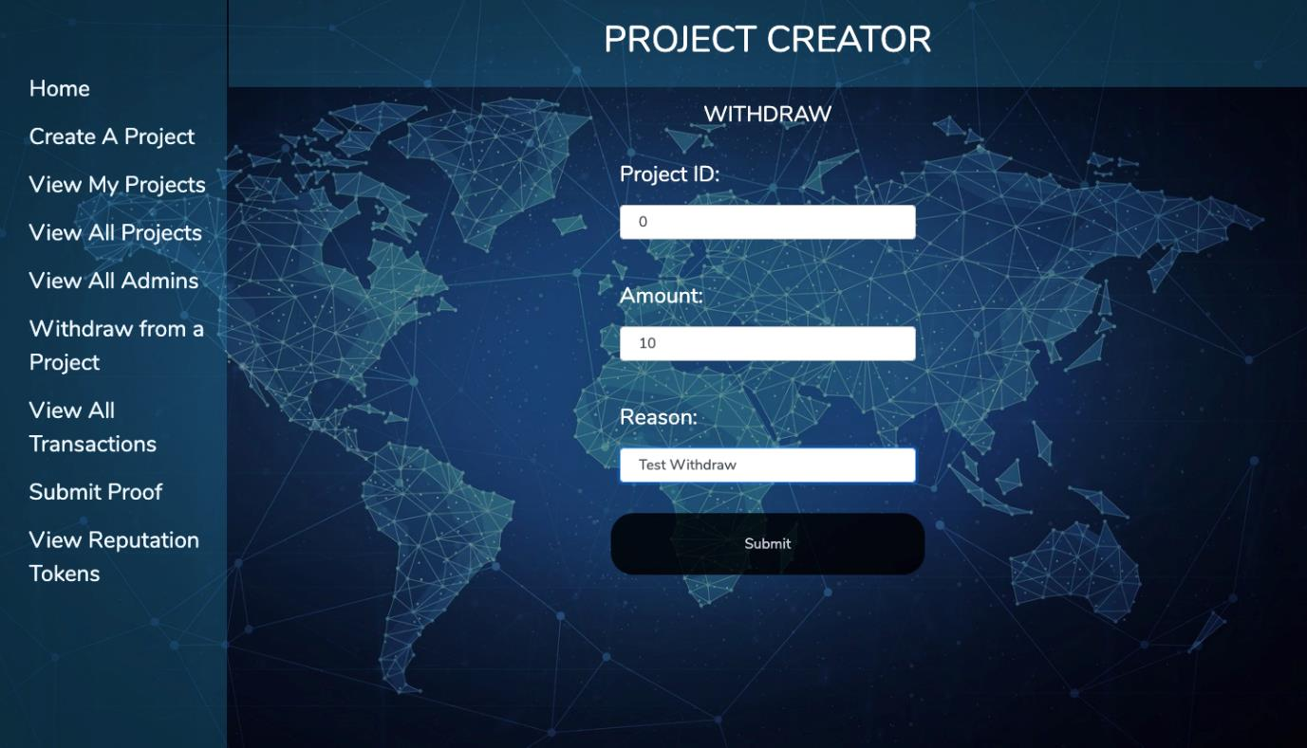
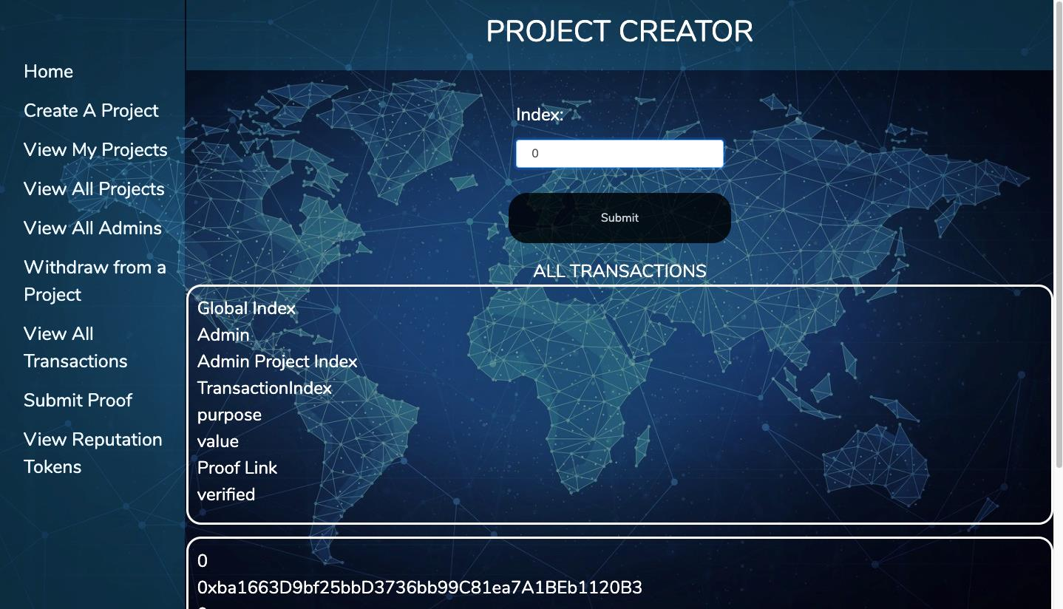
results - frontend
Withdraw for Project creator
View transactions for Project creator

Slide 23
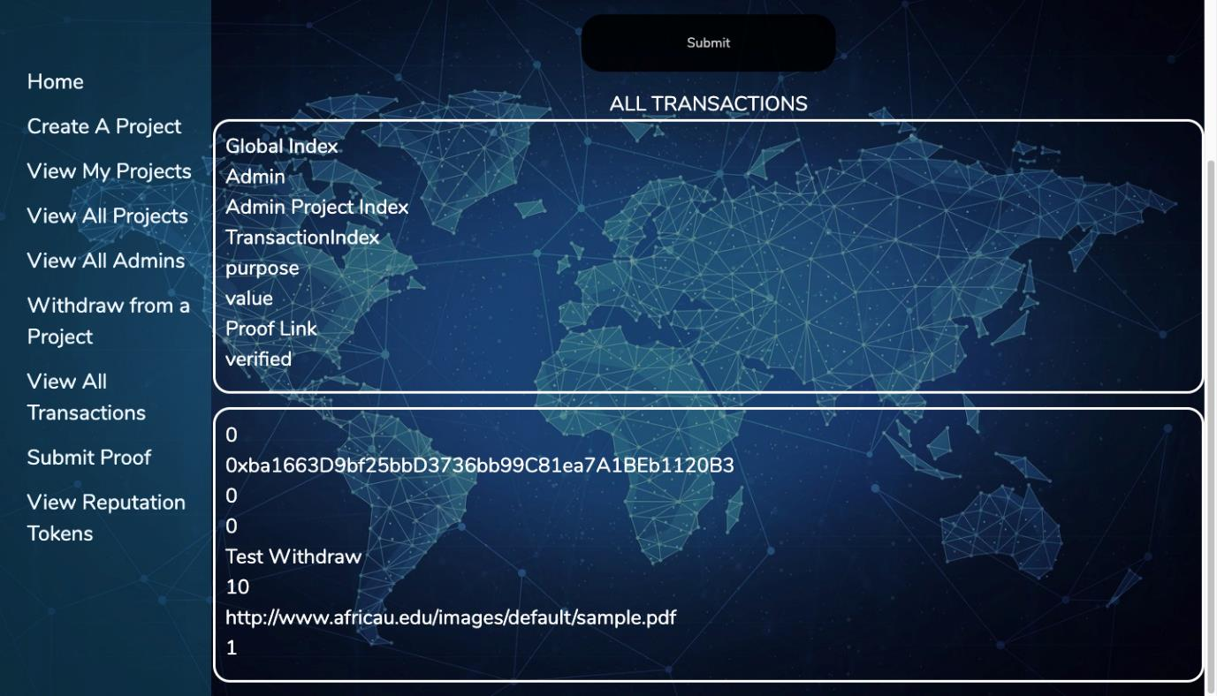
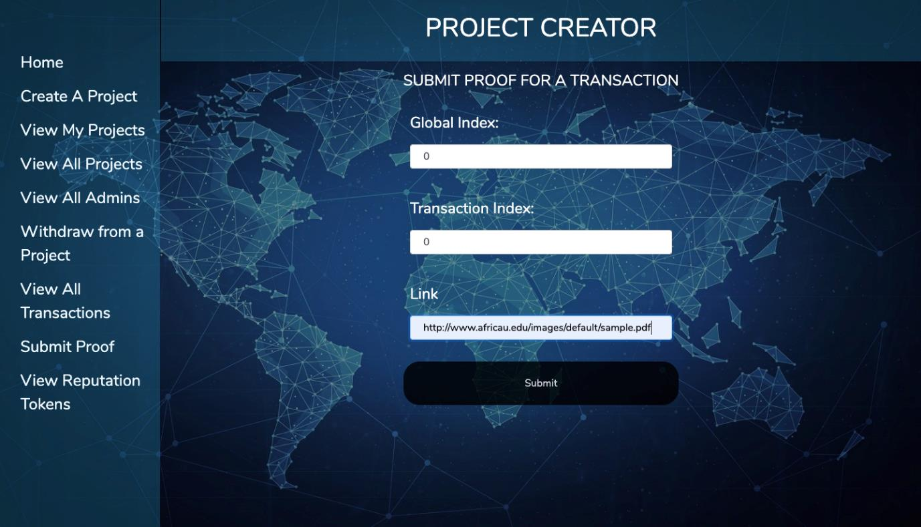
results - frontend
The following figures depicts the page that allows the project creator to submit proof for a transaction.
Submitting proof of transaction for Project creator

Slide 24
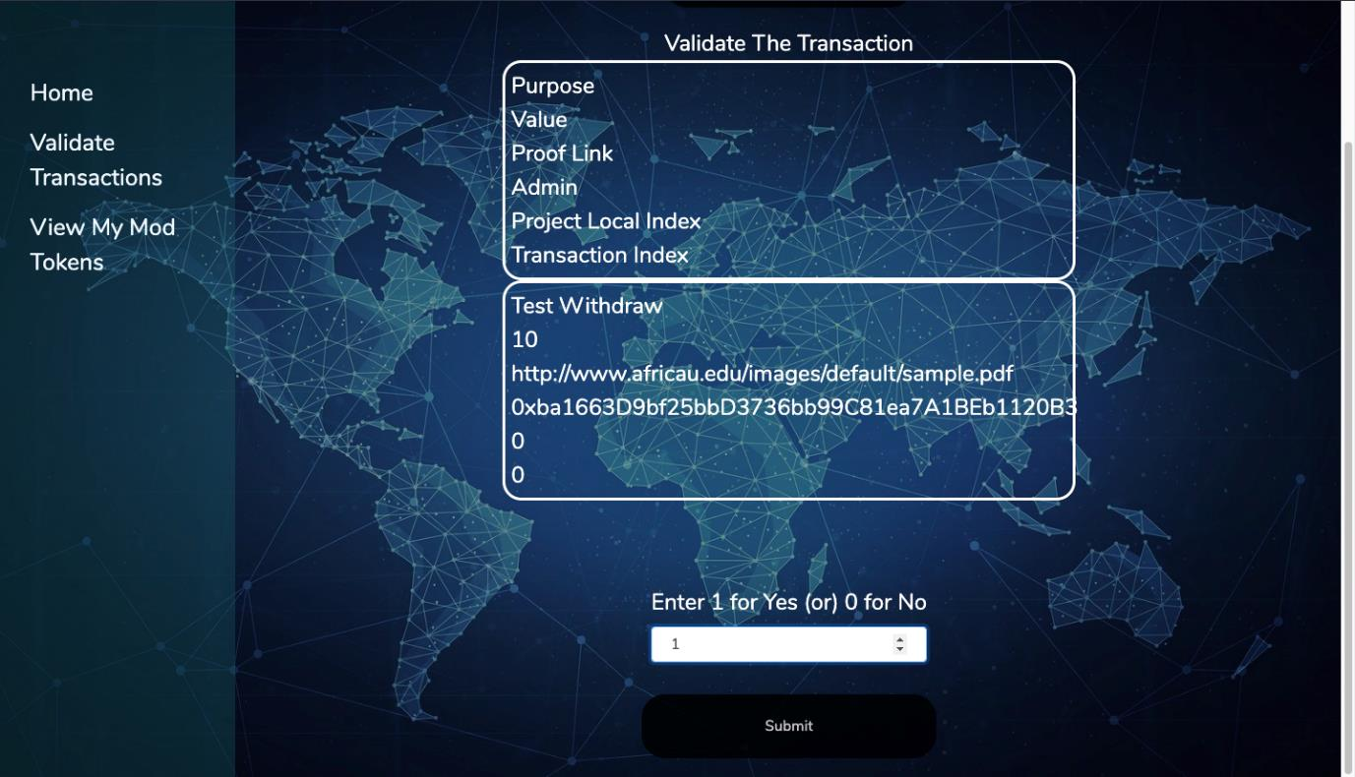
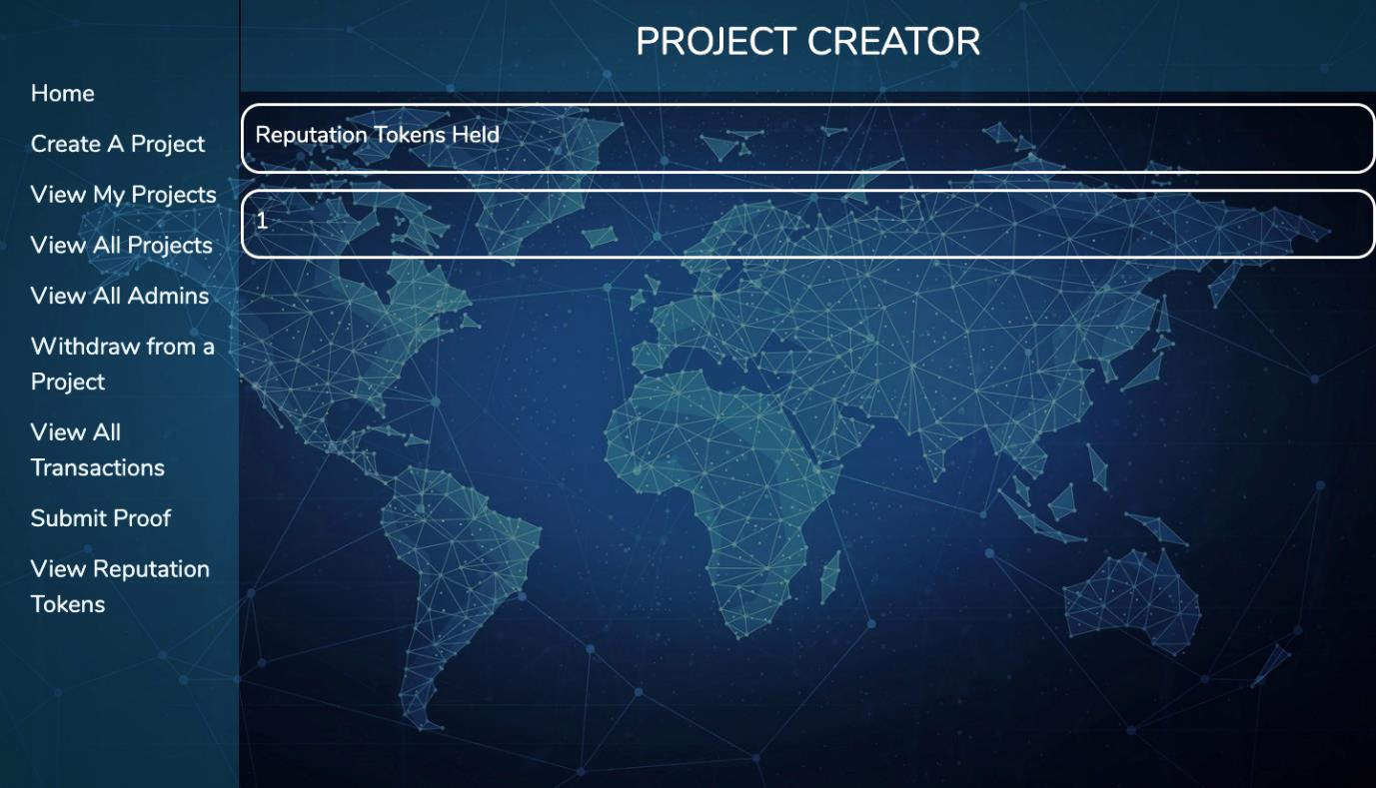
results - frontend
Validate transactions for Moderator
View reputation tokens for Project creator

Slide 25
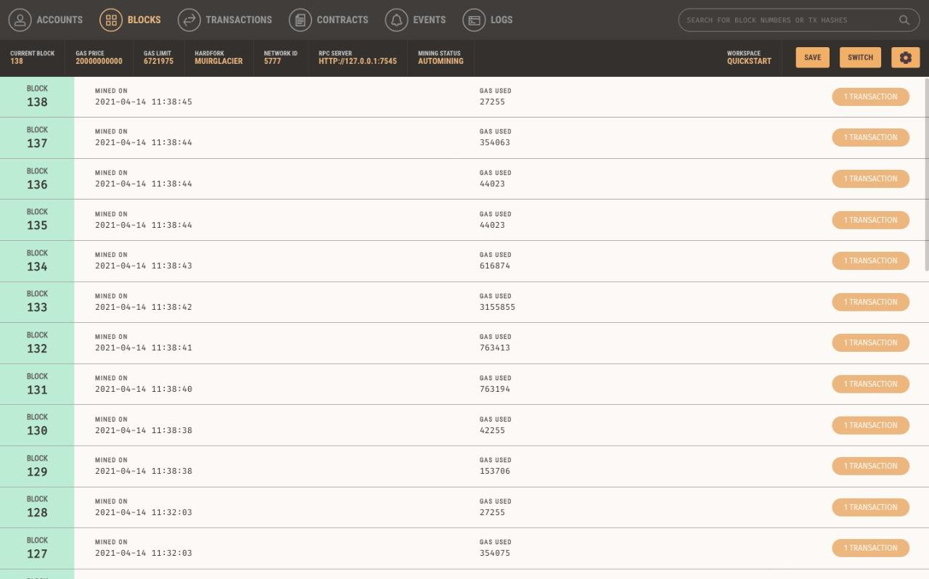
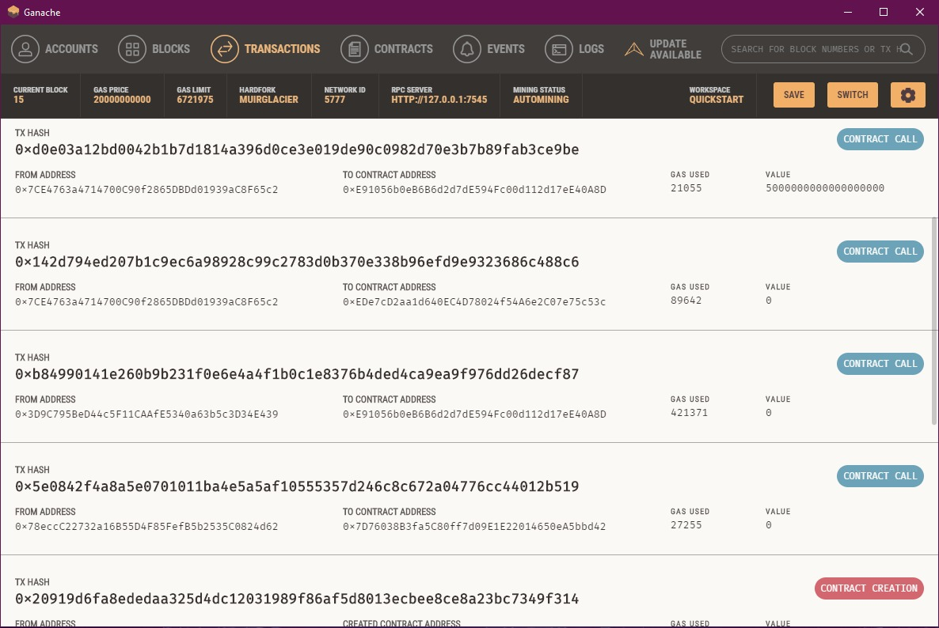
results - frontend
Transactions on the blockchain

Slide 26
CONCLUSION and Future Work
Crowdfunding using smart contracts intend to bring an easy and trust worthy way for Project Creators to kickstart their projects and to allow Donors to make safe donations for valuable causes.
There is no central entity controlling funds which prevents corruption and improves efficiency.
Using smart contracts, rules are enforced in the decentralised system and the smart contracts handle all the funds with code that is tested and proven to be strong against any kind of attack.
Future work would include:
An incentive for the Donor
Improved coin circulation.
Simple and easy interface.
A better way of performing transactions.

Slide 27
REFERENCES
Kangana W. M, Sowmya M, Namita Chougule, Sejal Patil, Soumya Kadadi, “The Applications of Blockchain Technology of Crowdfunding using Smart Contract”,International Research Journal of Modernization in Engineering Technology and Science Volume 02, Issue 09 ,September 2020.
Vikas Hassija, Vinay Chamola, Sherali Zeadally, “BitFund: A Blockchain-based Crowd Funding Platform for Future Smart and Connected Nation”,CDATA [Sustainable Cities and Society], (2020)
Pledgecamp, “Pledgecamp the next generation of crowd-funding,” https://pledgecamp.com/, online; accessed 11 January 2020.
Hasnan Baber,”Blockchain-Based Crowdfunding: A ‘Pay-it-Forward’ Model of WHIRL”,International Journal of Recent Technology and Engineering (IJRTE) ISSN: 2277-3878, Volume 8 Issue 3, September 2019.
“Blockchain: Smart Contracts,” GeeksforGeeks, 02-Jan-2020. [Online]. Available: https://www.geeksforgeeks.org/smart-contracts/. [Accessed: 3-Feb-2021].
“Introduction to Blockchain technology: Set 2,” GeeksforGeeks, 02-Dec-2019. [Online]. Available: https://www.geeksforgeeks.org/introduction-to-blockchain/. [Accessed: 3-Feb-2021].
“Proof of Work (PoW) Consensus,” GeeksforGeeks, 09-Jan-2019. [Online]. Available: https://www.geeksforgeeks.org/proof-of-work-pow-consensus/. [Accessed: 3-Feb-2021].
T. M. Team, “An overview of blockchain consensus protocols,” Medium, 05-Sep-2018. [Online]. Available: https://blog.modex.tech/an-overview-of-blockchain-consensus_x0002_protocols-9e9350b6c329. [Accessed: 3-Feb- 2021]

